Slide 1
Utopia vs. Dystopia

Slide 2
A Utopia is:
any visionary system of political or social perfection; an ideal place
Greek: ou—NOT
topos--PLACE

Slide 3
4/14 Quickwrite #31:
Our life dreams the Utopia. Our death achieves the ideal.
Victor Hugo Explain. Agree/Disagree?

Slide 4
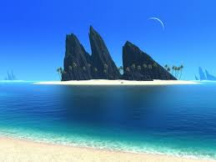
Bottom line:
Do Utopia’s exist?

Slide 5
A Dystopia is:
“dys” = “apart, negative, bad.”
We use it in words like “dysfunctional” or “disappear.”
When paired with “utopia” to give us “dystopia,” we have an image of a place that is the opposite of ideal, or ideal gone bad.

Slide 6
Dystopia in literature
an often-futuristic society that has degraded into a repressive state, often under the guise of being utopian.
iswarning society that if we continue to live how we do, this will be the consequence.
Propaganda, Figurehead worshipped, Surveillance, Fear outside world, Dehumanized state, Information, independent thought and Freedom are restricted.

Slide 7
The Course of the Empire
The painter Thomas Cole did a series of works called The Course of the Empire. It was based on a few lines from a poem by the poet Byron about the rise and fall of humanity. Byron wrote:

Slide 8
Byron Wrote:
There is the moral of all human tales;
This but the same rehearsal of the past
First Freedom, and then Glory: when that fails
Wealth, vice, corruption

Slide 9
Look through the paintings in the series, noticing how the sun rises and moves through the sky like a day beginning with the sun rise and ending with the sunset. The mountain in the background is a constant, but the foreground changes drastically. As you look through the paintings, think about the parallels between them and the rise and fall of civilizations.

Slide 10
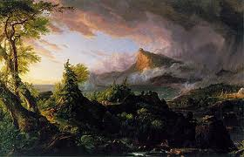
Painting Number 1: The Course of the Empire — Savage State

Slide 11
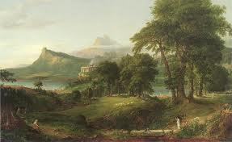
Painting Number 2: The Course of the Empire — Pastoral State

Slide 12
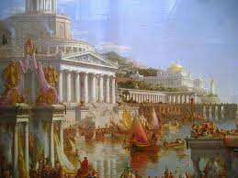
Painting Number 3: The Course of the Empire — Consummation of the Empire

Slide 13
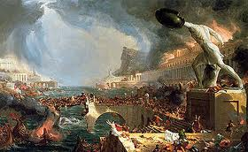
Painting Number 4: The Course of the Empire — Destruction

Slide 14
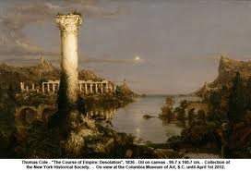
Painting Number 5: The Course of the Empire — Desolation

Slide 15
Also, answer question in journal:
Are the paintings Utopic or Dystopic? Can the same place be both Utopic and Dystopic?

Slide 16
So why do people write dystopian novels?

Slide 17
What social problems do we have currently? Both in the US and worldwide?

