Slide 1
Transcendentalism
Beliefs, Authors, and Quotations

Slide 2
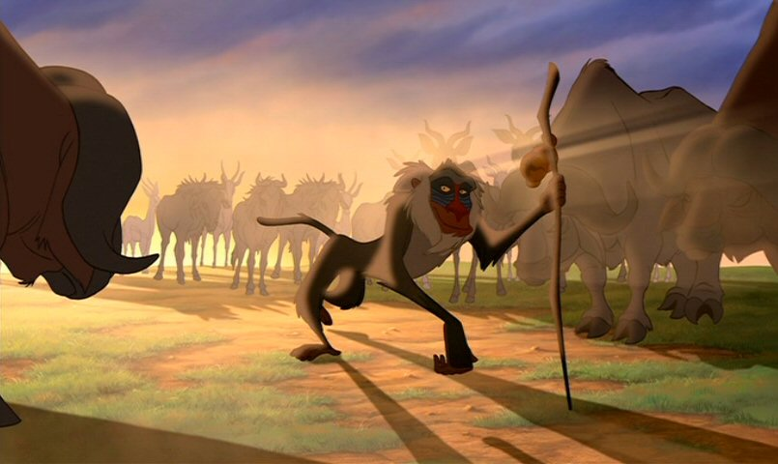
"LOOK BEYOND WHAT YOU SEE" - RAFIKI

Slide 3
Transcendentalism
Transcend – to go beyond
Beyond your senses
Beyond your day to day routine
Transcendentalists - philosophers & writers who rejected traditional religion
Don’t have to go to church to be religious.
So, where did they go?

Slide 4
Transcendentalism
Humans are naturally good
(Optimism)
Be self-reliant
Private inward prayer
(Love of Nature)
Act on own beliefs
(Individualism
Lead moral meaningful lives
(Oversoul)

Slide 5
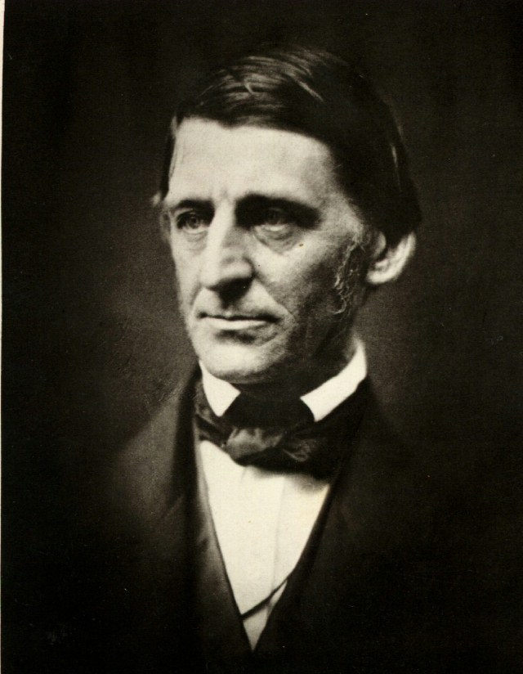
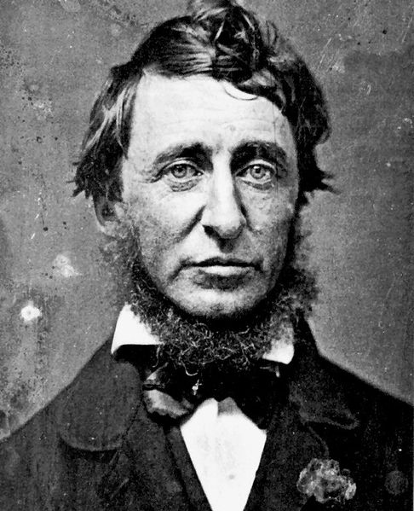
Transcendentalists
led by:
Ralph Waldo Emerson
Henry David Thoreau
"Nothing great was ever achieved without enthusiasm.“
- Ralph Waldo Emerson

Slide 6
Success
To laugh often and much
To win the respect of intelligent people and affection of children;
To earn the appreciation of honest critics
and endure the betrayal of false friends;
To appreciate beauty,
To find the best in others;
To leave the world a bit better,
Whether by a healthy child, a garden patch, or redeemed social condition;
To know even one life has breathed easier because you have lived.
This is to have succeeded.
-Ralph Waldo Emerson*

Slide 7
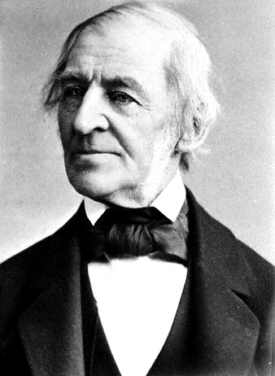
"What lies behind us and what lies before us are tiny matters compared to what lies within us."
- Ralph Waldo Emerson

Slide 8
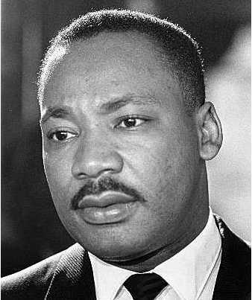
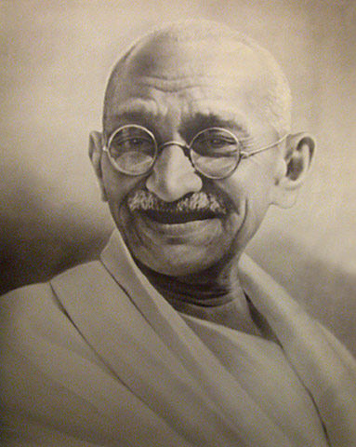
H. D. Thoreau
2 years at WP
writes:
Walden
Civil Disobedience
“must be true to your conscience even if it means breaking the law”

Slide 9
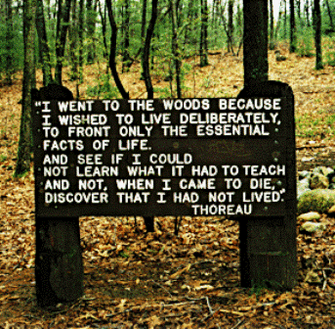
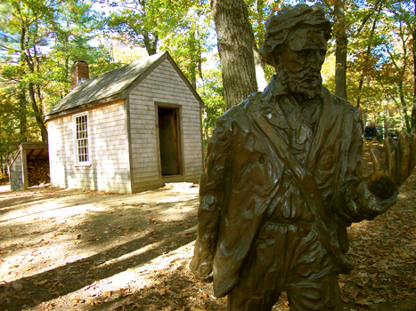

Slide 10
