Slide 1
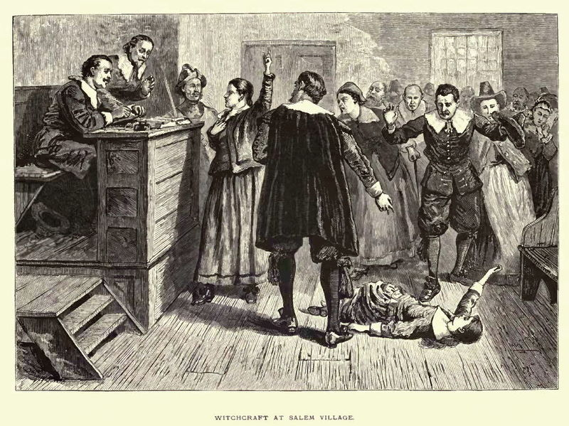
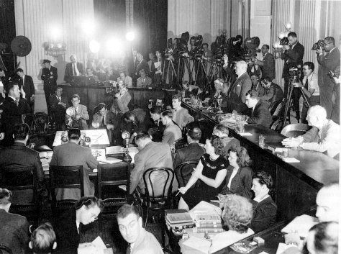
Salem Witch Trials and McCarthyism
Two moments of our nation’s mass hysteria collide in The Crucible.

Slide 2
What is mass hysteria?
Can you think of times when our nation (or the world) had a sudden, overwhelming fear about something?
Japanese internment in WWII
Salem Witch Trials in 1692
Fear of Arab-Americans post-9/11
Holocaust
Stalin’s regime in Russia
McCarthyism in the 1950s

Slide 4
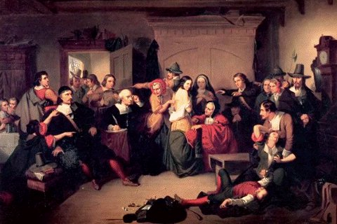
Salem Witch Trials
WHAT: Trials to prosecute people
accused of witchcraft
WHERE: Colonial Massachusetts
WHEN: Colonial time period (1692)
WHO: Young girls (who accused community members of witchcraft)
Community members (accused of witchcraft)
Magistrates and prosecutors
WHY: Puritan beliefs—Supernatural, Devil/Witches

Slide 6
McCarthyism
WHAT: Widespread fear of communism that led to US House and Senate hearings—in an attempt to uncover communist activities
WHEN: 1950s
WHERE: United States—in the nation’s capitol and around the country
WHO: Senator Joseph McCarthy (claimed there were Communists and Soviet spies in the federal government and elsewhere)
HUAC: House Un-American Activities Committee
Actors, Writers, Directors: blacklisted by the HUAC
WHY: Pervading fear of Communism, Soviet spies

Slide 7
Side-by-Side Comparison
Salem Witch Trials | McCarthyism
WHAT SIMILARITIES DO YOU SEE BETWEEN THESE TW0 TIME PERIODS?

Slide 8
What’s different? What’s the same?

Slide 9
Can You Imagine…
Imagine you’re an artist—doing what you love most. You’ve been fairly successful and people actually like your work. They like it enough to pay for it. You’re living your dream of working at what you love doing. And you’re making a difference. People enjoy your art and what you do. But all of this is put at jeopardy when one of your good friends and fellow artists turns in you in. He turns you in for a crime you didn’t commit.
HOW WOULD YOU FEEL?

Slide 10
Why Arthur Miller Wrote the Crucible…
Arthur Miller was an artist brought before the HUAC.
The story of The Crucible in some ways parallels his story.

